Slide 1

Retail Sales Dashboard: A Comprehensive Analysis
This presentation offers a deep dive into retail sales performance, leveraging an interactive Power BI dashboard.

Slide 2
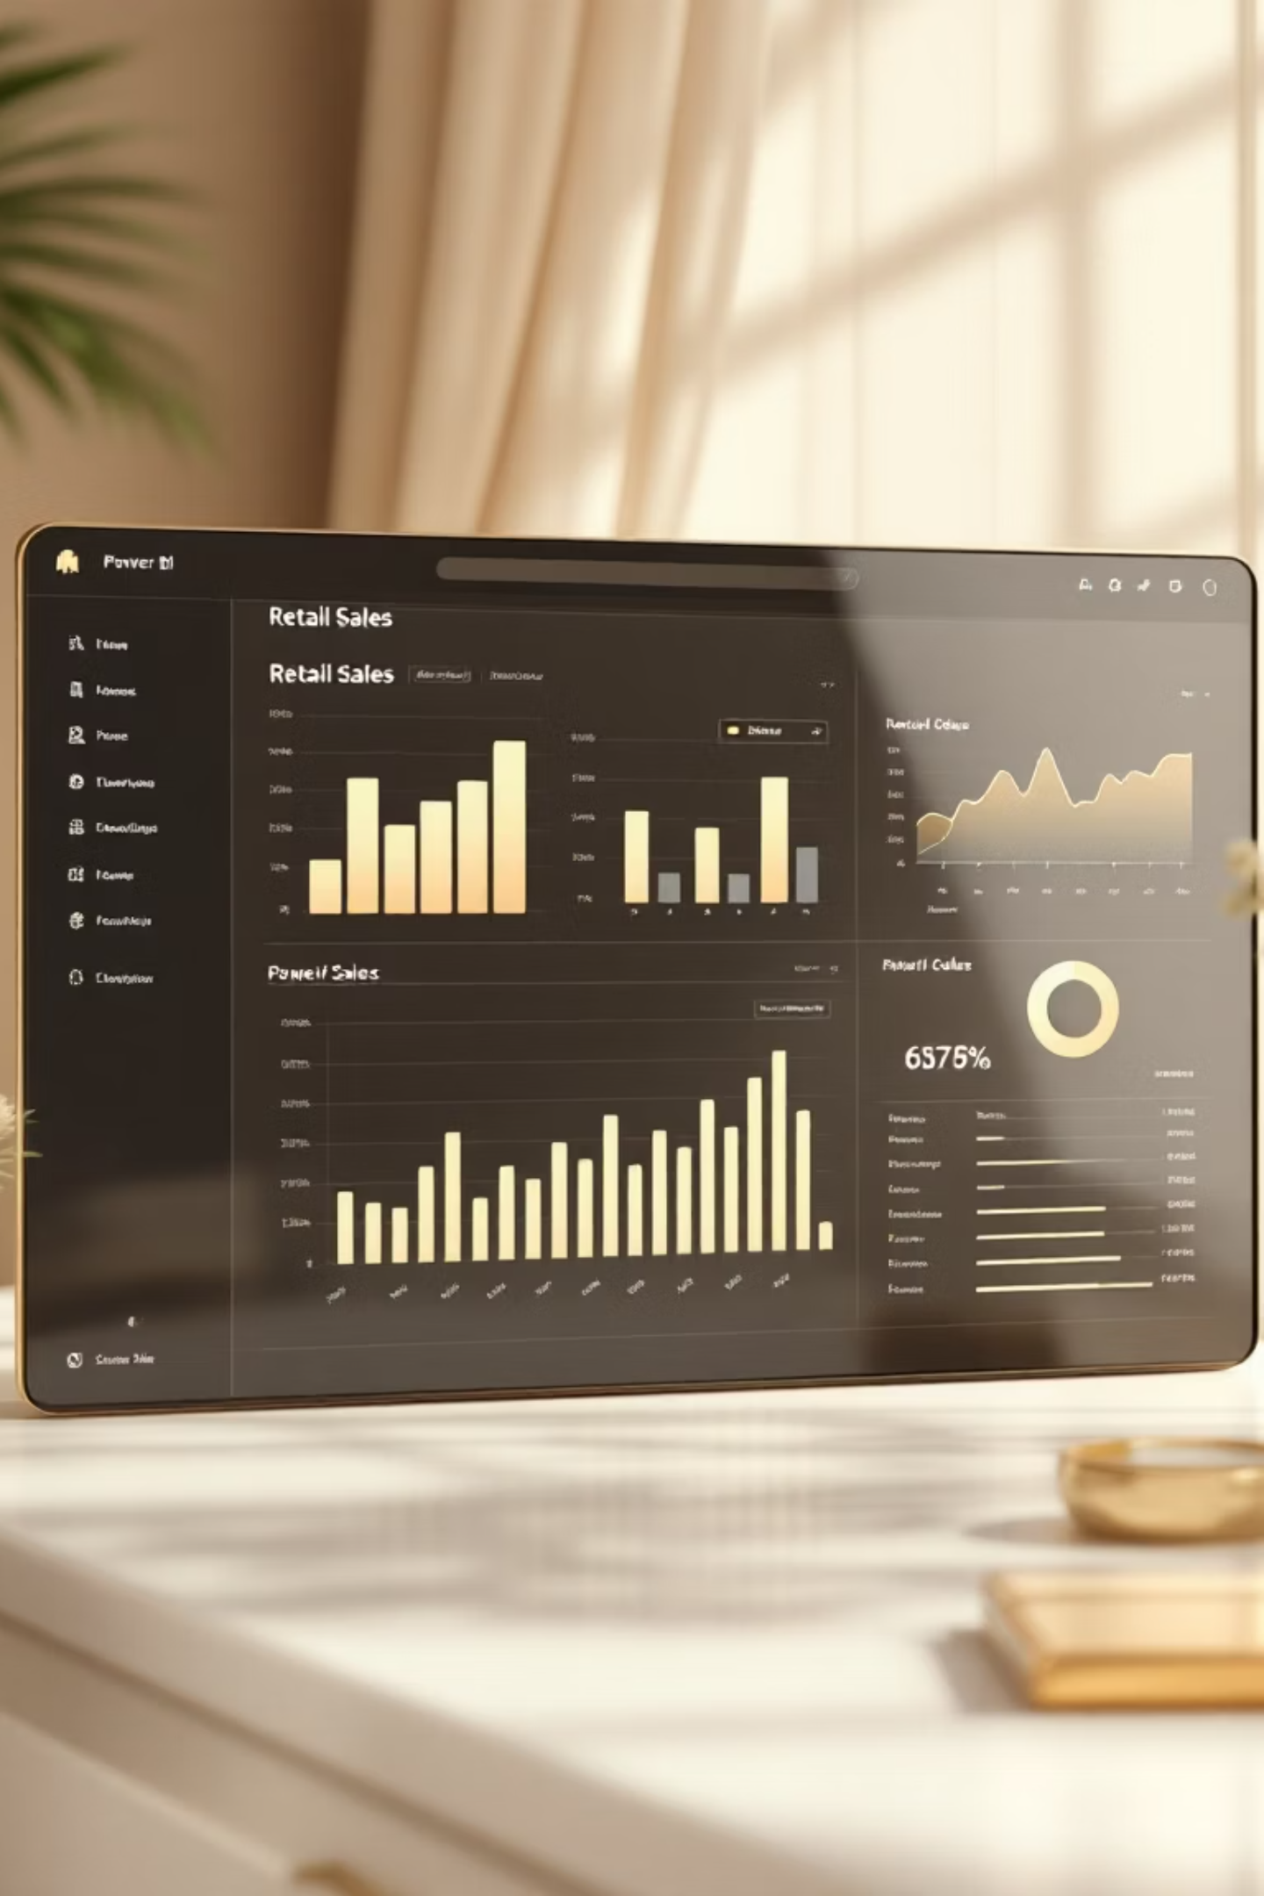
Retail Sales Dashboard
Built by: Tahir Jainapur
Tool: Power BI
Dataset: Online Retail Dataset

Slide 3


Dashboard Objectives
Analyze Sales Performance
To meticulously track and evaluate overall retail sales performance.
Monitor Key Metrics
To keep a close watch on vital metrics such as revenue, quantity sold, and customer demographics.
Identify Top Performers
To pinpoint the highest-performing product categories and most valuable customer segments.
Drive Strategic Decisions
To provide actionable insights through interactive visuals, aiding informed business decisions.

Slide 4

Dataset Overview & Key Insights
Dataset Columns Utilised:
Key Performance Indicators:
order_date
299
76.11K
product_name
category_name
Quantity Sold
Total Revenue
quantity
price
95
801.11
customer_id
gender
age
Transactions
Avg. Order Value
city
Top Product Category: Electronics
payment_method
Revenue Trend: Noticeable drop from 2024 to 2025.
Time Period: 2023 – 2025
Top Payment Method: Credit Card (37.23%), Bank Transfer (32.55%), Cash on Delivery (30.22%).
Sales by City: Revenue is concentrated in a limited number of cities, as shown on the sales map.

